Slide 1
Virtual Piano
Team: The DayDreamers
Sahil Chelaramani (20162051)
Pranav Dhakras (20162303)

Slide 2
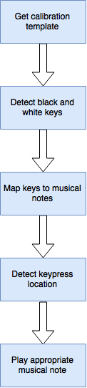

Slide 3
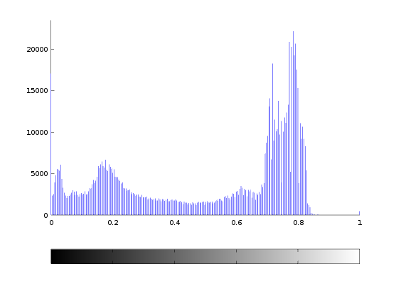
Detecting keys
Get calibration template
Otsu’s thresholding for multiple thresholds

Slide 4
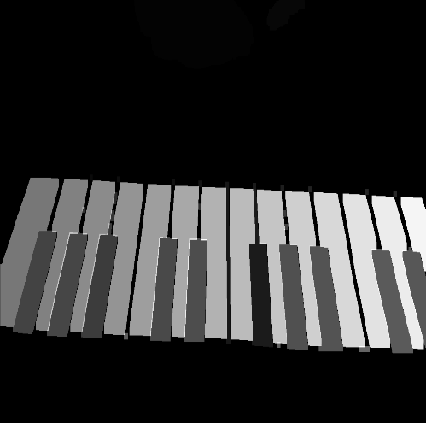
Detecting keys
Connected component analysis
Unique ID for each key

Slide 5
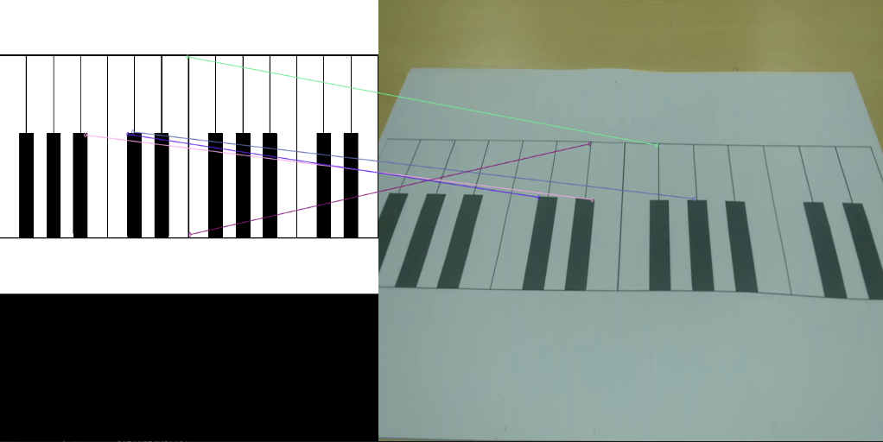
Using homography
Extract feature points from template and video frame
Match points
Find homography
Issues due to symmetry

Slide 6
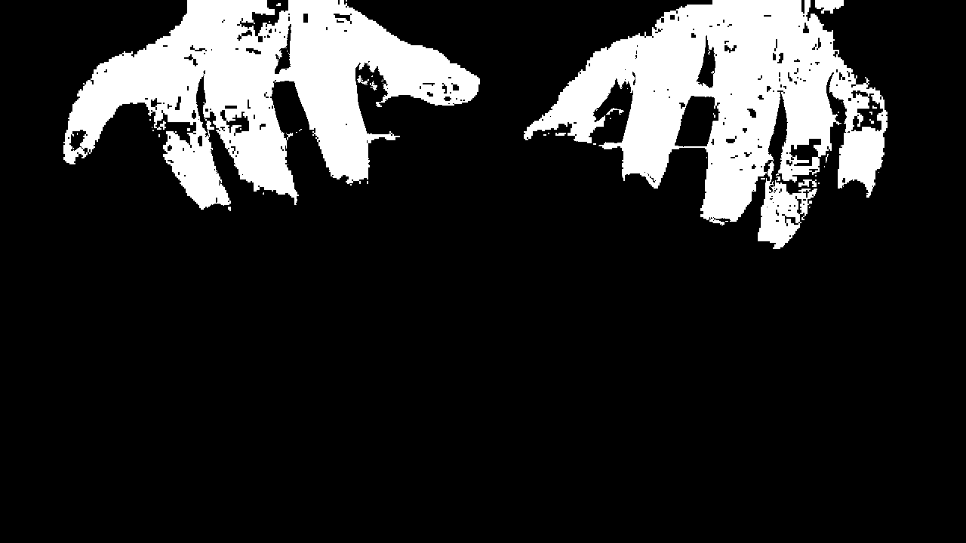
Contour fitting for skin colour
Apply thresholding to get mask of hands
Very sensitive to skin colour and factors such as nail paint

Slide 7
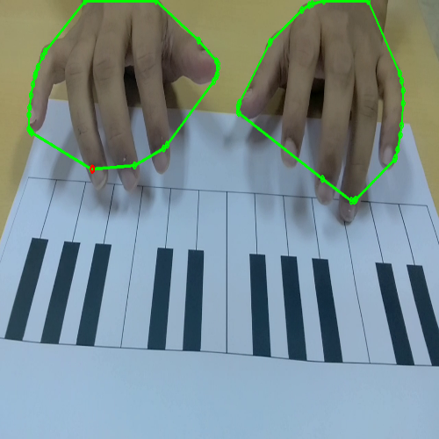
Contour fitting for skin colour
Get convex hull of hands
Find highest y-point from hull
Approximate it as fingertip
Problems:
Works for only one finger
Problem with hovering fingers

Slide 8
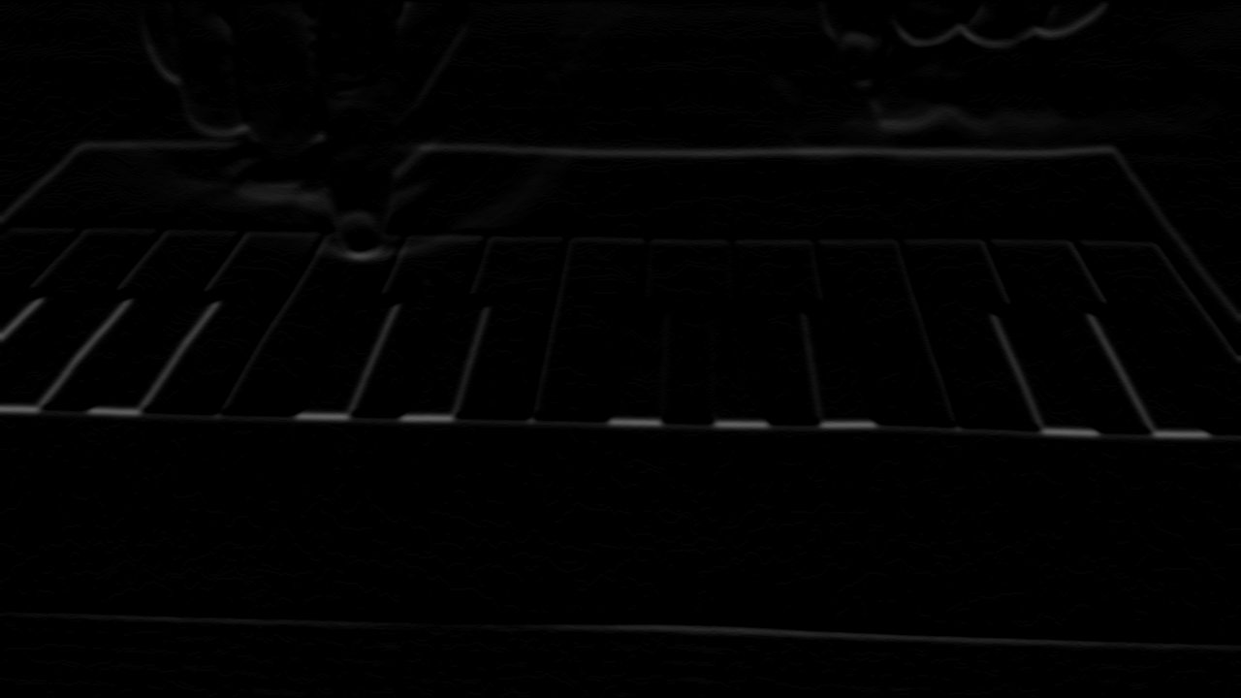
Detecting white keys
Sobel operator
Crescent shaped response when key is pressed

Slide 9

Activity map and smart thresholding

Slide 10
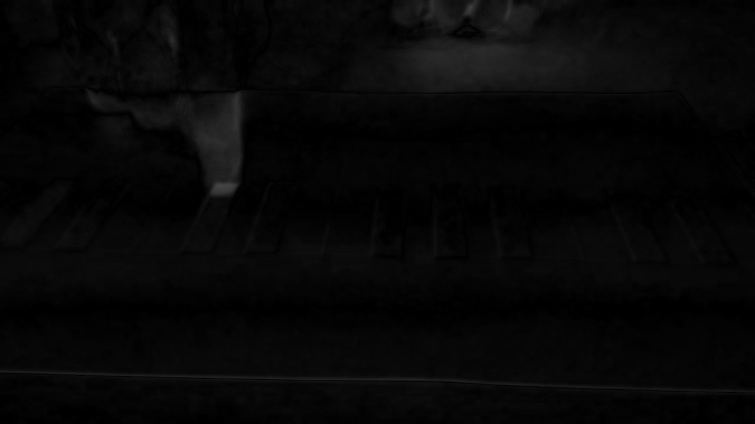
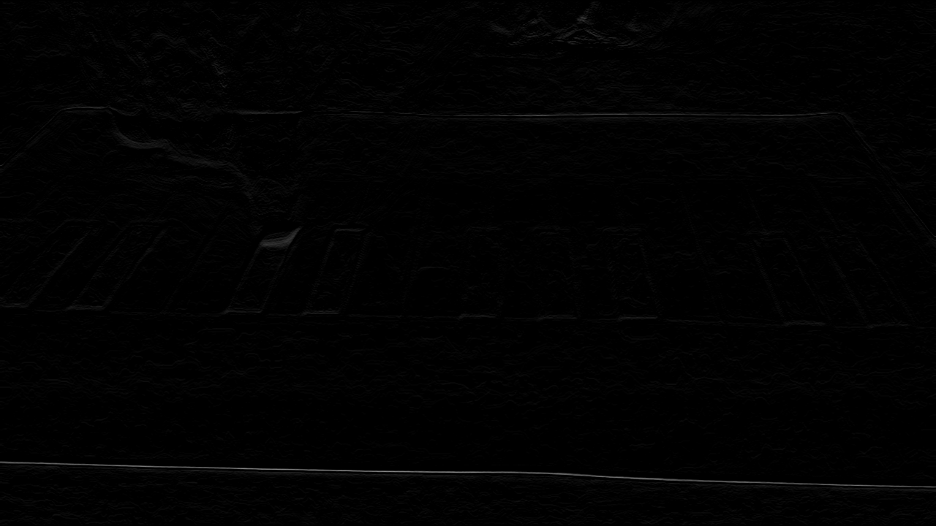
Detecting black keys

Slide 11
Filtering duplicate key presses
Problems due to activity map
Use of queue to solve the issues

Slide 12
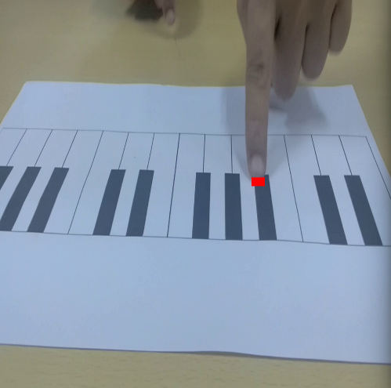
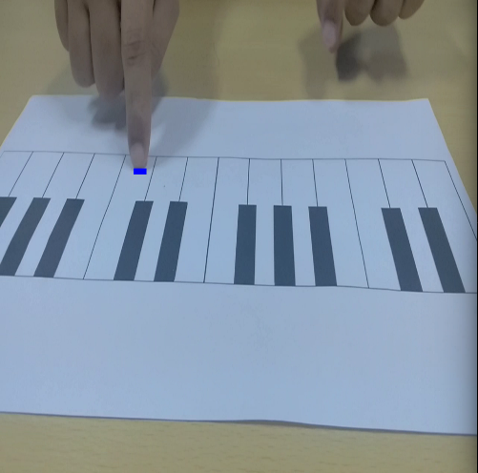
Results

Slide 13
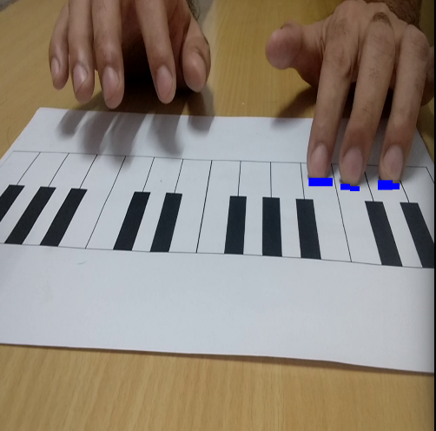
Results

Slide 14
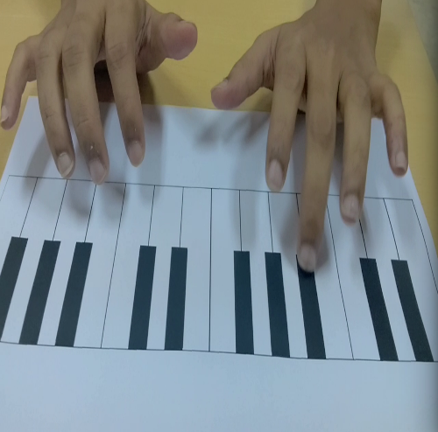
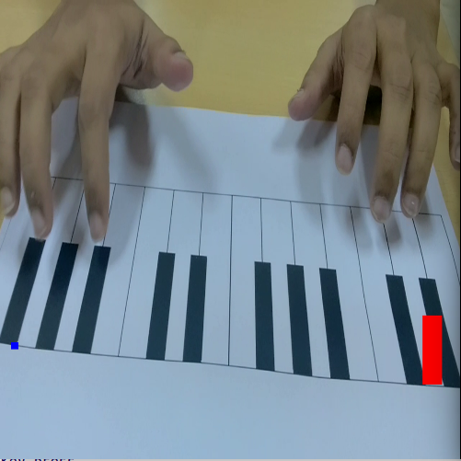
Failure cases

Slide 15
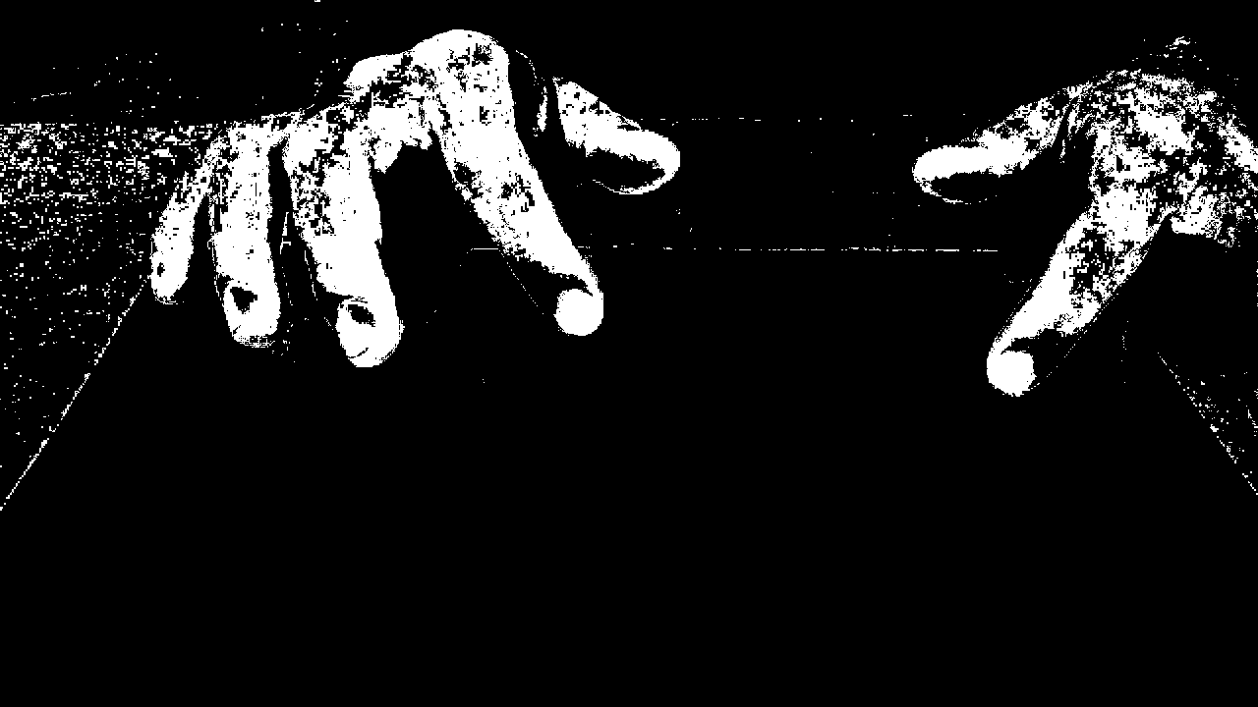
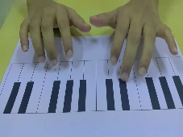
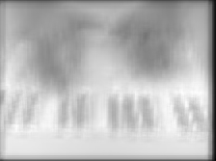
Future work
Skin detection
Using CNNs to detect presses
Depth maps

Slide 16
Thank you !

